Slide 1
Employee Data Analysis using Excel
STUDENT NAME : KAVIYA.K
REGISTER NO :2213371036126
DEPARTMENT :B.COM(GENERAL)
COLLEGE : QUAID-E-MILLATH GOVERNMENT COLLEGE.

Slide 2
PROJECT TITLE
Employee Performance Analysis using Excel

Slide 3


AGENDA
Problem Statement
Project Overview
End Users
Our Solution and Proposition
Dataset Description
Modelling Approach
Results and Discussion
Conclusion
3/21/2024 Annual Review

Slide 4

PROBLEM STATEMENT
We have to track the performance of employees work motive for the organization and So that we can completely focus on the growth and structure of the organization and also to develop their personal skills and talents.
We have to motivate the best and executive employees with increments, promotion and bonus.
We have to train and motivate the under developed employees in a and effective manner with proper specifications.

Slide 5

PROJECT OVERVIEW
EMPLOYEE DATA ANALYSIS
Analysing the performance of the employees by considering the various factors like Gender, Performance score , Ratings and their Achievements , inorder to identify the trends and patterns of different categories of employees like high, medium and low.

Slide 6






WHO ARE THE END USERS?
EMPLOYEE
MANAGER
EMPLOYEE HIERARCHY
EMPLOYER

Slide 7

OUR SOLUTION AND ITS VALUE PROPOSITION
CONDITIONAL FORMATTING – TO IDENTIFY THE MISSING DATA
FILTER – FOR THE PURPOSE OF REMOVING THE UNWANTED DATA.
FORMULA- FOR IDENTIFYING THE PERFORMANCRE THE EMPLOYEES .
PIVOT TABLE - TO CONVERT THE DATA INTO SHORT SUMMARY .
GRAPH – DATA VISUALIZATION

Slide 8
Dataset Description
EMPLOYEE = KAGGLE
26- FEATURES
9- FEATURES
EMPLOYEE – ID – NUMERICAL VALUES.
NAME – TEXT
EMPLOYEE TYPE
PERFORMANCE LEVEL
GENDER – MALE , FEMALE
EMPLOYEE RATING – NUMERICAL VALUES

Slide 9

THE "WOW" IN OUR SOLUTION
PERFORMANCE LEVEL=IF(Z8>=5, "VERY HIGH", IF(Z8>=4, "HIGH", IF(Z8>=3, "MEDIUM", "LOW")))
3/21/2024 Annual Review
9

Slide 10
MODELLING
DATA COLLECTION
Downloaded the employee data performance from EDUNET DASHBOARD
FEATURE COLLECTION
Identified each feature and working on to find out the performance level.
To find out the high and medium level employees.
DATA CLEANING
Identified the missing values.
Filtered the missing values.
PERFORMANCE LEVEL
SUMMARY
PIVOT TABLE
PIE CHART
VISUALIZATION
Graph to understand in a reliable and easy manner .
10

Slide 11
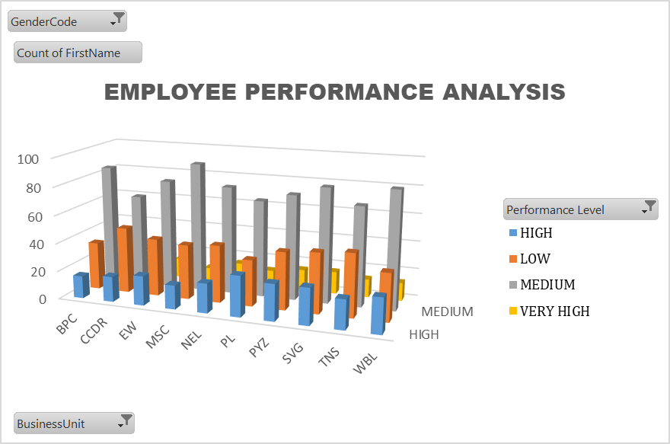
RESULTS
11

Slide 12
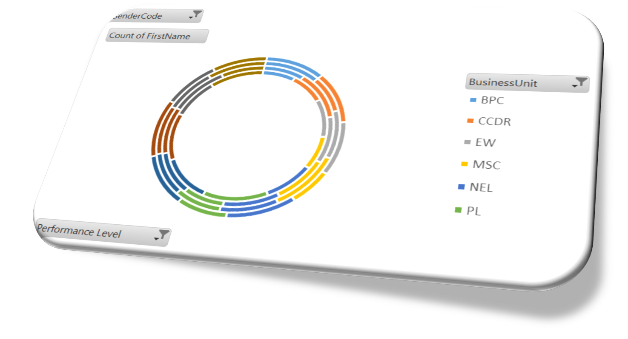
RESULTS
HIGH LEVEL EMPLOYEES
12

Slide 13
conclusion
EMPLOYEE PERFORMANCE ANALYSIS
BY COMPARING THE PERFORMANCE OF THE EMPLOYEES. THE EMPLOYEES ARE HIGHER IN NUMBER. THERE ARE MORE PEOPLE IN AVERAGE LEVEL EMPLOYEES.
WE HAVE TO MOTIVATE THE EMPLOYEES TO DEVELOP THEIR SKILLS AND TALENTS TO ACHIEVE THE ORGANISATIONAL GOALS AND OBJECTIVES TO REACH THE PLACE OF HIGH LEVEL PERFORMANCE TO SUSTAIN THE GOALS AND TARGETS.
WE HAVE TO TRAIN AND DEVELOP THE EMPLOYEES WITH BETTER OUTCOME TO REACH THE ORGANISATIONAL GOALS.
.

